Slide 1
Enhancing Robotic Vision through Vision-Language Models: A Trash Sorting Framework with Physically Grounded Understanding
Joe Lisk, Prakrit Sinha, Sam Komonosky

Slide 2
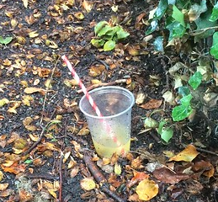
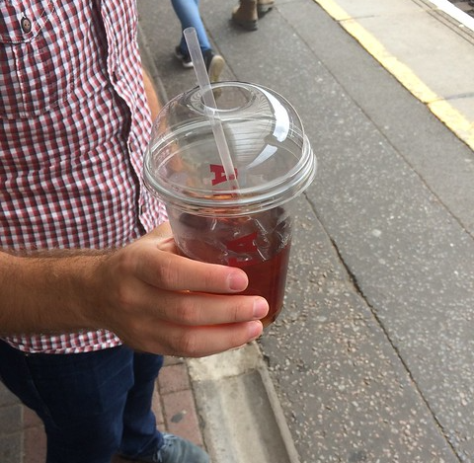
Problem Description
Trash detection has few datasets with small number of data.
TACO has 1500 images, 4784 annotations
Definition of trash is ambiguous
Trash classification is highly context-dependent
“Trash” objects can have a large, diverse number of class labels.
Difficult to train on every kind of label

Slide 3
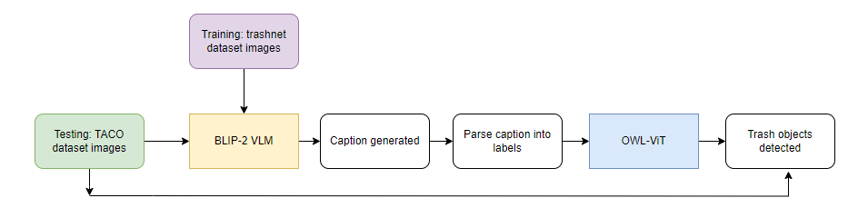
Methodology
Trained the BLIP-2 VLM on trashnet dataset (~2500 images).
Original dataset had labels in the form of a numeric id (0-5), in order to generate captions we mapped these label ids into text categories (0:cardboard, 1:glass, 2:metal, 3:paper, 4:plastic, 5:trash).
Captions were then parsed and fed as labels into a zero-shot (model which can predict on unseen class labels) object detection model: OWL-ViT

Slide 4
Challenges
Problem: Fine-tuning PG-Instruct BLIP on custom datasets proved intractable
Problem: COCO objects had objects where trash/not trash classification was ambiguous
Problem:
Generated caption words not always usable as a set of class labels
Generated caption inconsistent for single image
OWL-ViT detects objects that would be very unlikely to be trash (e.g tables)
Generated caption is sometimes not that useful
Ex. can can of soda can with green and white background
Problem:
Training + Inference on VLM + Inference on OWL-ViT computationally expensive

Slide 5
Solutions
PG-Instruct BLIP issue:
Used BLIP-2 for fine tuning (precursor to PG-Instruct BLIP)
COCO Dataset issue:
Fine-tuned BLIP-2 on Trashnet dataset (well defined categories of trash; all objects trash)
Caption-related issues:
Match words in caption with classes in unseen TACO dataset to use as labels for OWL-ViT
Potential solution: natural language processing methods for caption refinement
Computational complexity issue:
Open issue

Slide 6
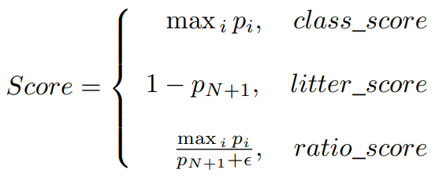
Baseline method
Mask RCNN used for TACO dataset, segments compared against ground truth segments.
Faster RCNN can be used for general object detection. Bounding box compared against ground truth bounding box.
Metric: Bounding box score using IoU. Class label score using AP. (TACO uses slightly different metric)
Comparison metric still an open issue with our work
[2]

Slide 7
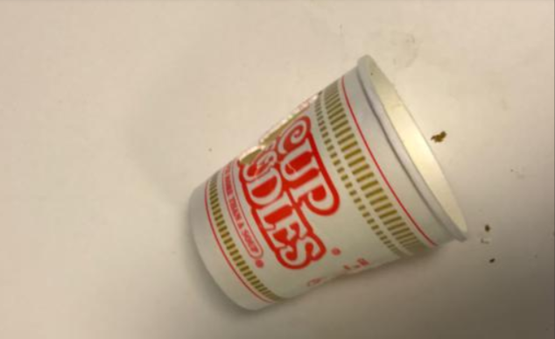
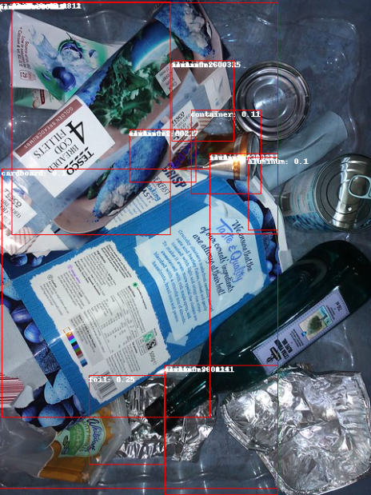

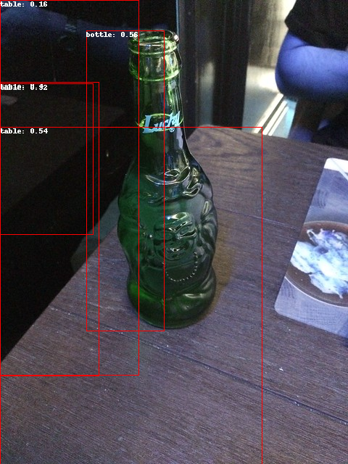
Results:
Able to detect trash objects with unseen labels in training data (zero-shot)
Able to detect cluttered objects
BLIP-2 image captioning:
OWL-ViT zero-shot:
caption

Slide 8
Future Work
This project:
Create a metric to compare performance of our method with baseline
Future research ideas:
Increase the number of images in trash datasets for greater scene contexts and richer labels
Single architecture for caption -> label generation -> zero-shot object detection with less computational cost
Include scene context in the label for object

Slide 9
References
[1] Dive into VLM article: A Dive into Vision-Language Models (huggingface.co)
[2] Taco Paper: https://arxiv.org/abs/2003.06975
[3] Taco Dataset: http://tacodataset.org/
[4] Trashnet Dataset: https://huggingface.co/datasets/garythung/trashnet
[5] BLIP-2 Paper: https://huggingface.co/docs/transformers/en/model_doc/blip-2
[6] OWL-ViT Paper: https://huggingface.co/docs/transformers/en/model_doc/owlvit

Slide 10
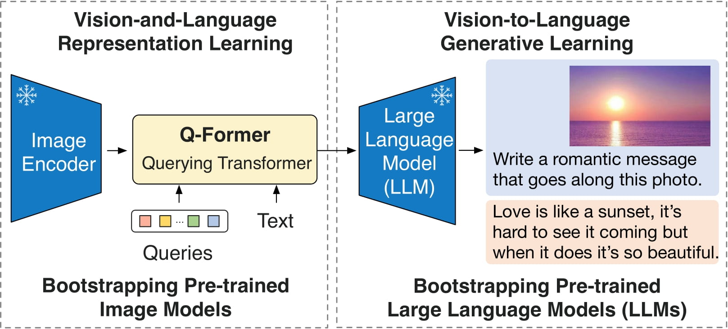
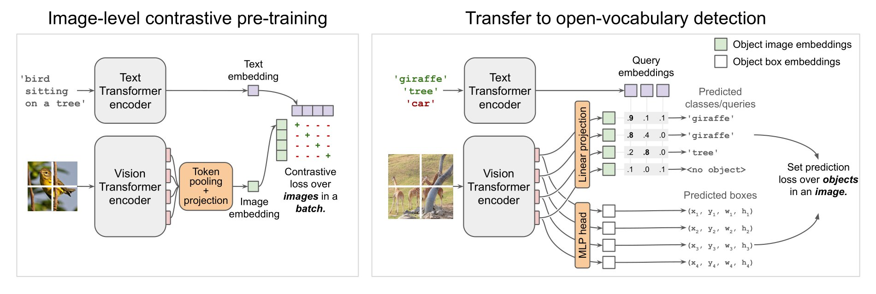
BLIP-2 Architecture [5]
OWL-ViT Architecture [6]

